Slide 1

OOSA&D(2017)
One of a Kind Objects: the Singleton Pattern

Slide 2
Review:The Factory Method Pattern
The Factory Method Pattern defines an interface for creating an object, but lets subclasses decide which class to instantiate. Factory Method lets a class defer instantiation to subclasses.

Slide 3
glossary
simplicity
perspective
singleton
controller
global
thread
multithreading
简易
视角
单例
控制器
全局的
线程
多线程

Slide 4
Agenda
A Case Analysis
Design Pattern: The Singleton Pattern
In-class practice
An experiment in class
Practices of design pattern as homework
Dalian Neusoft University of Information © Copyright

Slide 5
Agenda
A Case Analysis
Design Pattern: The Singleton Pattern
In-class practice
An experiment in class
Practices of design pattern as homework
Dalian Neusoft University of Information © Copyright

Slide 6

Case: The Chocolate Factory
To fill the boiler it must be empty;
To drain the boiler it must be full and also boiled.
To boil the boiler it must be full and not already boiled.

Slide 7
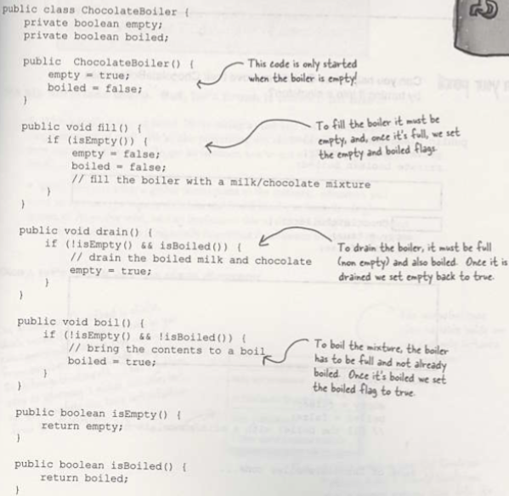
Case: The Chocolate Factory(P175)

Slide 8
Case: The Chocolate Factory(P175)
How might things go wrong if more than one instance
of ChocalateBoiler is created in an application?

Slide 9

Question:
Can you improve the ChocolateBoiler class into which only one instance of ChocalateBoiler is created in the application?

Slide 10
Real World Scenario
Sometimes it's appropriate to have exactly one instance of a class:
window manager
print spooler
Filesystems
press Ctrl-F to display a Find dialog.

Slide 11
Real World Scenario
why we care?
creating lots of objects can take a lot of time
extra objects take up memory
it is a pain to deal with different objects floating around if they are essentially the same

Slide 12
Agenda
A Case Analysis
Design Pattern: The Singleton Pattern
In-class practice
An experiment in class
Practices of design pattern as homework
Dalian Neusoft University of Information © Copyright

Slide 13
Class diagram: Singleton Pattern
Holds our one and only
instance of Singleton.
You can conveniently access
the method anywhere?

Slide 14
The Singleton Pattern
The Singleton Pattern ensures a class has only one instance, and provides a global point of access to it.

Slide 15
The Singleton Pattern
Intent
Ensure a class has only one instance, and provide a global point of access to it.
Encapsulated "just-in-time initialization" or "initialization on first use".

Slide 16
The Singleton Pattern
Problem
Application needs one, and only one, instance of an object. Additionally, lazy initialization and global access are necessary.

Slide 17
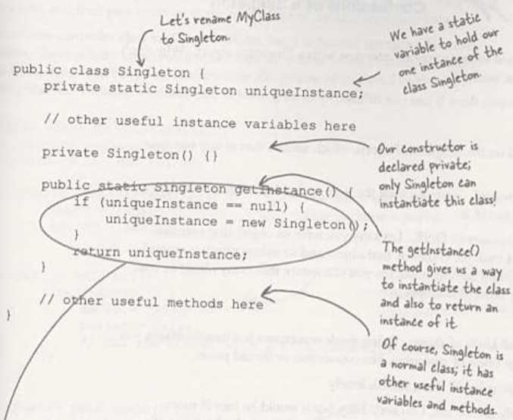
The Singleton Pattern

Slide 18
Singleton pattern
singleton: an object that is the only object of its type
ensures that a class has at most one instance
provides a global access point to that instance
takes responsibility of managing that instance away from the programmer (illegal to construct more instances)
provide accessor method that allows users to see the (one and only) instance
possibly the most known / popular design pattern! (this should tell you something)

Slide 19
Restricting objects
One way to avoid creating objects: use static methods instead
Math, System, JOptionPane
is this a good alternative choice? Why or why not?
Problem: lacks flexibility
Example: static methods can't be passed as an argument to a method, nor returned
Problem: cannot be extended
Example: static methods can't be subclassed and overridden like a singleton's could be

Slide 20
Implementing Singleton
make constructor(s) private so that they can not be called from outside
declare a single static private instance of the class
write a public getInstance() or similar method that allows access to the single instance
possibly protect / synchronize this method to ensure that it will work in a multi-threaded program

Slide 21
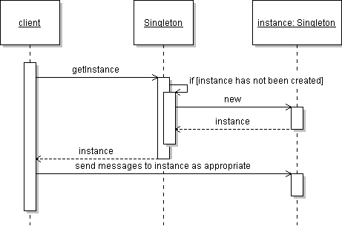
Singleton sequence diagram

Slide 22
Singleton example
consider a class RandomGenerator that generates random numbers
public class RandomGenerator {
private static RandomGenerator gen;
public static RandomGenerator getInstance() {
return gen;
}
private RandomGenerator() {}
public double nextNumber() {
return Math.random();
}
}

Slide 23
An eagerly created instance(p181)
consider a singleton class RandomGenerator that generates random numbers
public class RandomGenerator {
private static RandomGenerator gen = new RandomGenerator();
public static RandomGenerator getInstance() {
return gen;
}
private RandomGenerator() {}
public double nextNumber() {
return Math.random();
}
}
possible problem: always creates the instance, even if it isn't used

Slide 24
Dealing with multithreading
variation: solve concurrency issue by locking
// Generates random numbers.
public class RandomGenerator {
private static RandomGenerator gen = null;
public static synchronized
RandomGenerator getInstance() {
if (gen == null)
gen = new RandomGenerator();
return gen;
}
}
Is anything wrong with this version?

Slide 25

Double checking locking(P182)
variation: solve concurrency issue without unnecessary locking
// Generates random numbers.
public class RandomGenerator {
private volatiel static RandomGenerator gen = null;
public static RandomGenerator getInstance() {
if (gen == null) {
synchronized (RandomGenerator.class) {
if (gen == null)
gen = new RandomGenerator();
}
}
return gen;
}
}

Slide 26
Summary so far..
Problem
Want to ensure a single instance of a class, shared by all uses throughout a program
Context
Need to address initialization versus usage ordering
Solution
Provide a global access method (static)
First use of the access method instantiates the class
Constructors for instance are made private

Slide 27
Summary so far..(P186)
OO Basics
Abstraction
Encapsulation
Inheritance
Polymorphism
OO Principles
Encapsulate what varies
Favor composition over inheritance
Program to interfaces not to implementations
Strive for loosely coupled designs between objects that interact
Classes should be open for extension but closed for modification.
Depend on abstraction. Do not depend on concrete classes.

Slide 28
Checkpoints
What is singleton pattern?
What is the purpose of singleton pattern?
How to apply singleton pattern to multithreading environment?

Slide 29
3.In-class practice
Case 01: ID Number（case01）
One person can and only can have only one ID number.
Your job is to…
Design the class diagram
program according to your class diagram
Test your design with the price $60.
Dalian Neusoft University of Information © Copyright

Slide 30
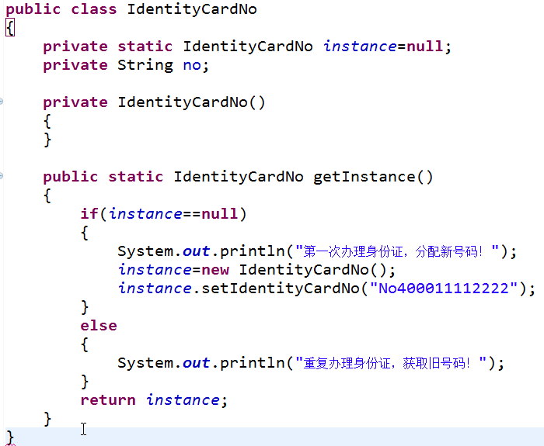
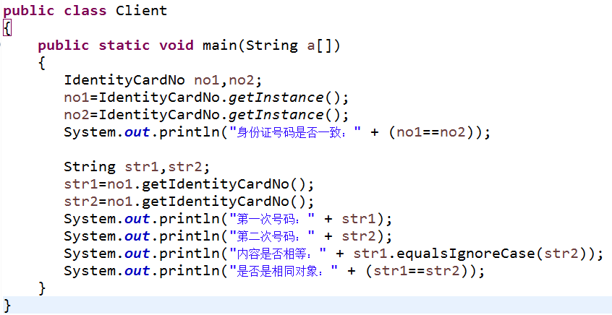
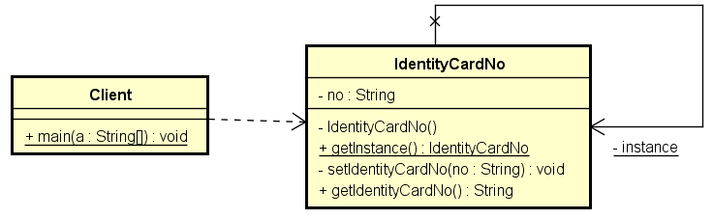
In-class practice
Dalian Neusoft University of Information © Copyright

Slide 31
4.An experiment
ex01：Print pool（ex01） In operating system, the print pool ( print spooler ) is an application that manages print tasks, allowing a print pool user to delete, abort, or change the priority of the print tasks,only one print pool object can run in a system.An exception will ben thrown if the print pool is created repeatedly. Singleton pattern is used to simulate the design of print pool.
Your job is to…
Design the class diagram
program according to your class diagram
Test your design.
Dalian Neusoft University of Information © Copyright

Slide 32
5.Homework
Finish the homework, which includes 3 tasks.
Dalian Neusoft University of Information © Copyright

